Slide 1
Week 1
Entity Relationship Diagrams – SEMANTIC GuideLINES – Part 6

Slide 2
Student Objectives
Upon completion of this video, you should be able to:
Follow the guidelines and properly label your ER Diagram

Slide 3
General Semantic Guidelines
Use either all singular names for the entities or all plural names but not both (preferably singular)
Try to use meaningful names, try to make the relationships read from left to right and from top to bottom
QUESTION: What’s wrong with this example?
N
Doctor
Patient
M
Doctors
Patient
IS TREATED BY
Treats
1
EMPLOYS
Is employee by
QUESTION: Label the cardinality on the above diagram:
M
Nurse
Nurse
Notes:
Doctors is plural,
Should read left to right if possible
Should read top to bottom if possible
Cardinality: Patient is treated by Doctor: Many to Many
Doctor employees Nurse: One to Many

Slide 4
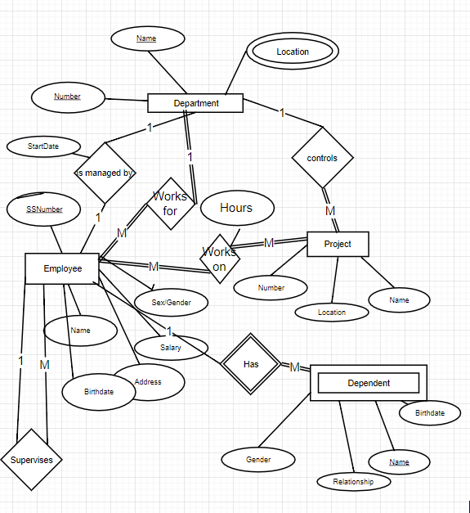
Our Case Study so Far:
Let’s use draw.io to fix it up a little!

Slide 5
Using Visio instead of Draw.io
MSVisio → http://www.csd.uwo.ca/~lreid/cs3319/usingvisio/usingvisio.html

